Slide 1




Web Framework Programming
Topic 9:
Update &
Delete
WEEK 9 Informatics Engineering
Universitas Surabaya
Informatics Engineering | Universitas Surabaya
Notes:
Cover Half
Gambar vector bisa didownload di: https://scale.flexiple.com/illustrations/
Jika ingin foto free royalty bisa download di: https://pixabay.com/photos/

Slide 2
Update Data
https://laravel.com/docs/10.x/eloquent#updates
Informatics Engineering | Universitas Surabaya

Slide 3
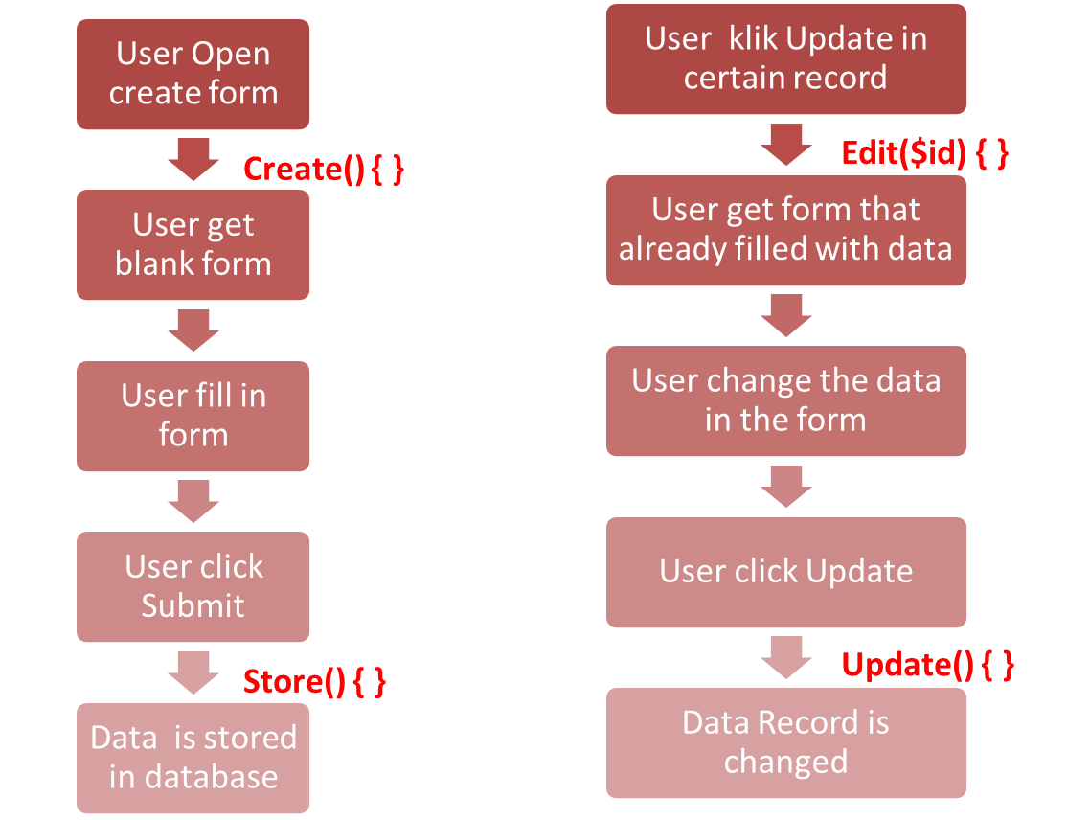
Create vs. Update
Informatics Engineering | Universitas Surabaya

Slide 4
Exercise #1: create an Edit Form
Informatics Engineering | Universitas Surabaya

Slide 5
Steps
Prepare a routing for the update form
Prepare the link/button in the records then check the routing first.
Create a new view. can re-use the existing code in ‘create form’. Fill the input field with the selected record. Call it in controller.
Informatics Engineering | Universitas Surabaya

Slide 6
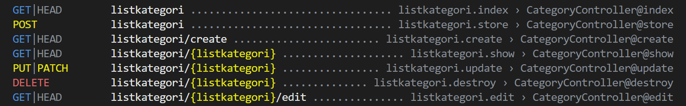
Prepare routing and Controller
If we use Resource Controller
we can follow the existing method.
Check php artisan route:list syntax
Informatics Engineering | Universitas Surabaya

Slide 7
Focus on ‘edit’ function
GET|HEAD listkategori/{listkategori}/edit ............... listkategori.edit › CategoryController@edit
GET|HEAD is a HTTP Method
listkategori/{listkategori}/edit is a format URI for showing edit form and its existing data
{listkategori} -> will be replaced with number/string as the ID / Primary key of category table
Example :
http://localhost:8000/category/2798880729352657/edit
user will got edit form with the existing data for category with id = 2798880729352657
In Laravel, calling the edit form can use these 2 syntax:
With url : url (‘category/’.$category->id.’/edit’)
With route_name : route(‘category.edit’,$category ->id)
Informatics Engineering | Universitas Surabaya

Slide 8
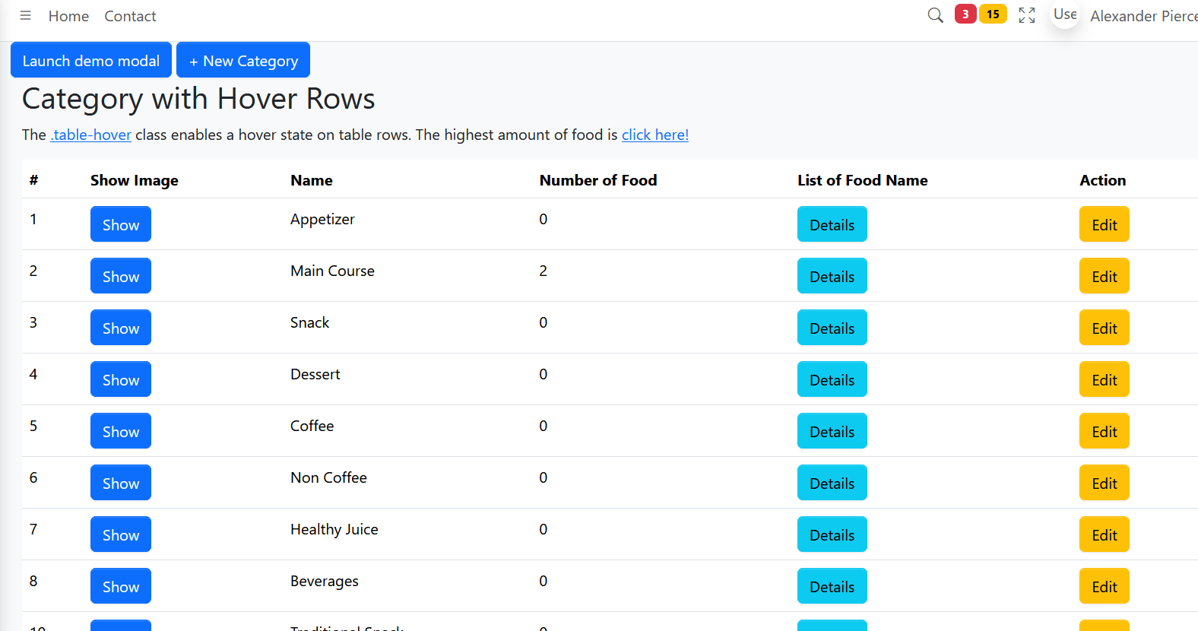
Example of Category Edit Form Action
For 10 minutes,
open your index-view of your Category
Add action “Edit”
Hover your mouse inside “Edit” button and look at the link. Is it similar to your routes?
Informatics Engineering | Universitas Surabaya

Slide 9
Prepare the link/button in your citizen/index.blade.php file
Add new column for “action”
Add new link for “show edit form”
<table class="table">
<thead>
<tr>
<th>ID</th>
<th>Name</th>
<th>Column X</th>
……
<th>Action</th>
</tr>
</thead>
<tbody>
@foreach ($data as $d)
<tr>
<td>{{ $d->id }}</td>
<td>{{ $d->name }}</td>
<td>{{ $d->dataX }}</td>
………
<td>
<a class="btn btn-warning" href="{{ route('listkategori.edit’, $d->id) }}">Edit</a>
</td>
</tr>
@endforeach
</tbody>
</table>
Informatics Engineering | Universitas Surabaya

Slide 10
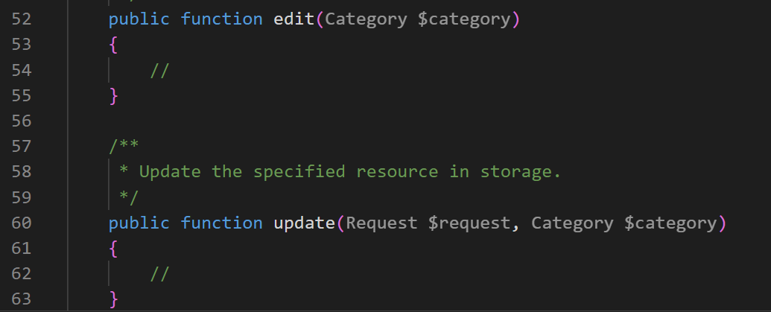
Check the routing & Controller
Method “edit” provides a parameter of Model Class. We can use it to retrieve the data that will be updated.
Method “update” provides two parameters, first $request from Form and second Model. We can use it to retrieve the data that will be updated from Form.
Informatics Engineering | Universitas Surabaya

Slide 11
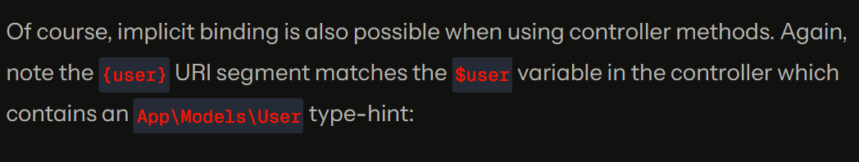
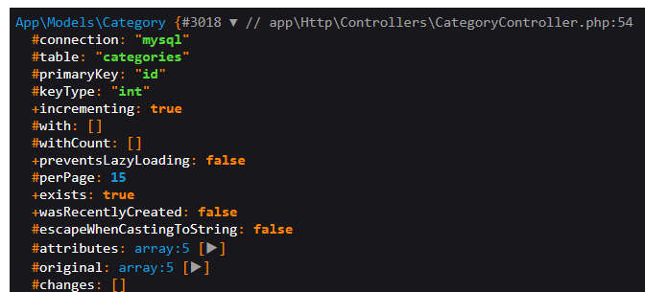
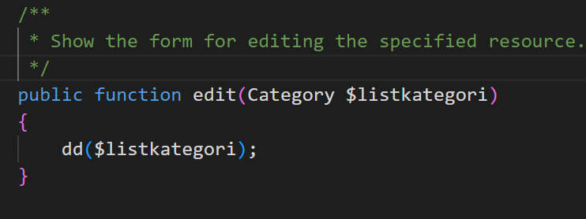
Check first your “Route Model Binding”
https://laravel.com/docs/10.x/routing#route-model-binding
Change $category to $listkategori for compile “route model binding” rule

Slide 12
Create a view, fill with current record
Create a new view named category/edit.blade.php. Re-use and modify code in category/create.blade.php and modify the edit method
public function edit(Category $listkategori)
{
return view(‘category.edit’, compact(‘listkategori’));
}
Edit your HTML Blade with “value” parameter inside input tag
Informatics Engineering | Universitas Surabaya

Slide 13
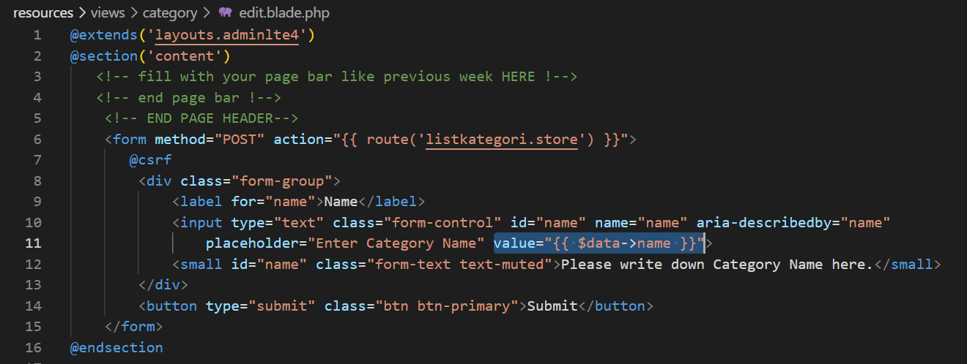

Slide 14
Exercise #2: Processing the updated data
Informatics Engineering | Universitas Surabaya

Slide 15
The Update() method
The process for saving the updated data is directed to some method in controller via submit button. In resource controller, it is already prepared in method update()
Informatics Engineering | Universitas Surabaya

Slide 16
Routing
Check the route:list,
what is the URL and the route name ?
what the HTTP method use to get into update() method ?
To make HTTP PUT method, we use POST method and adding this syntax:
@method(“PUT”)
- The {listkategori} must be replaced with the ID of the current record
Informatics Engineering | Universitas Surabaya

Slide 17
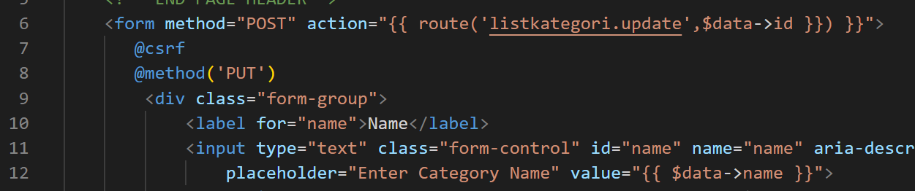
Modify the category/edit.blade.php
Informatics Engineering | Universitas Surabaya

Slide 18
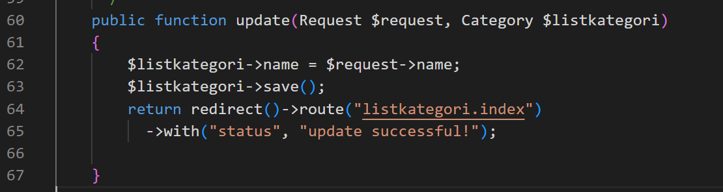
Code the update() method
Fill the table column with the corresponded request data, then save the data.
Use redirect with flash data for confirmation
Informatics Engineering | Universitas Surabaya

Slide 19
Delete Data
https://laravel.com/docs/10.x/eloquent#deleting-models
Informatics Engineering | Universitas Surabaya

Slide 20
Steps
Prepare a routing for the delete
Prepare the link/button in the records then check the routing first.
Code the controller method to delete the data
Informatics Engineering | Universitas Surabaya

Slide 21
Exercise #1: Adding delete button
Informatics Engineering | Universitas Surabaya

Slide 22
The destroy() method
In resource controller, deleting record can use the provided method: the destroy() method.
The method for removing data is DELETE. It can be used POST method and replaced with DELETE by using
@method(‘DELETE’)
It use url ‘listkategori/{listkategori}’
Or route name listkategori.destroy
Informatics Engineering | Universitas Surabaya

Slide 23
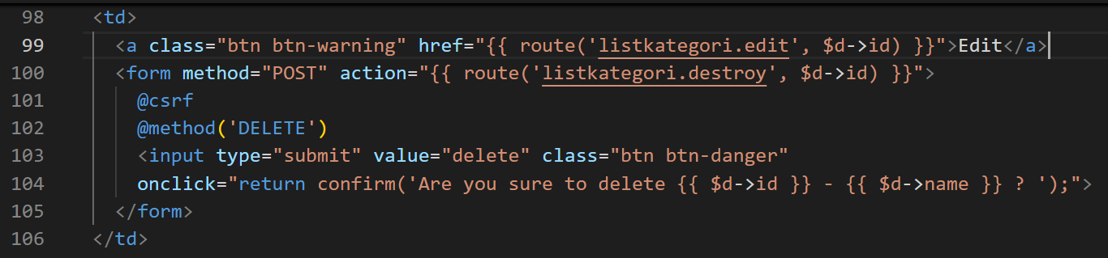
The Delete Button
The delete button is not open any form. It directly contacting the controller. Therefore, the delete button must be wrapped in a Form element and the delete button typed is a submit button.
Informatics Engineering | Universitas Surabaya

Slide 24
Additional
The “Delete” button is very crucial and the action is immediately executed. If someone accidentally clicks it, the data will be deleted directly without any confirmation.
It is fully recommended to provide a confirmation script in the delete button.
Informatics Engineering | Universitas Surabaya

Slide 25
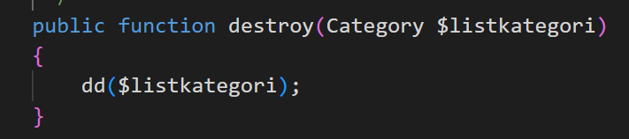
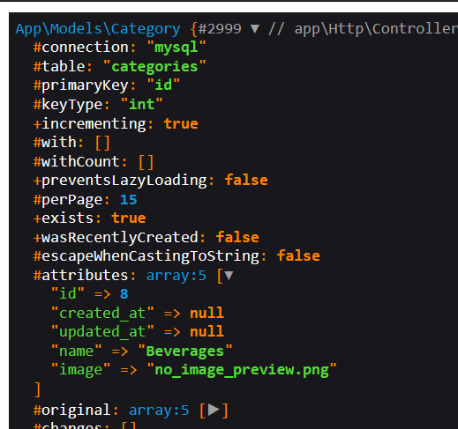
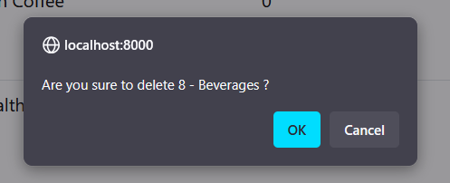
Try your delete route
Informatics Engineering | Universitas Surabaya

Slide 26
Exercise #2: Deleting data in database
Informatics Engineering | Universitas Surabaya

Slide 27
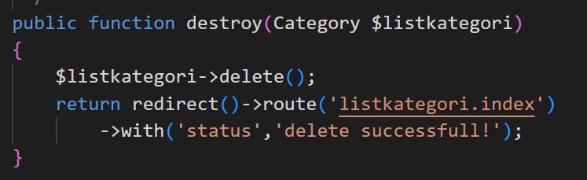
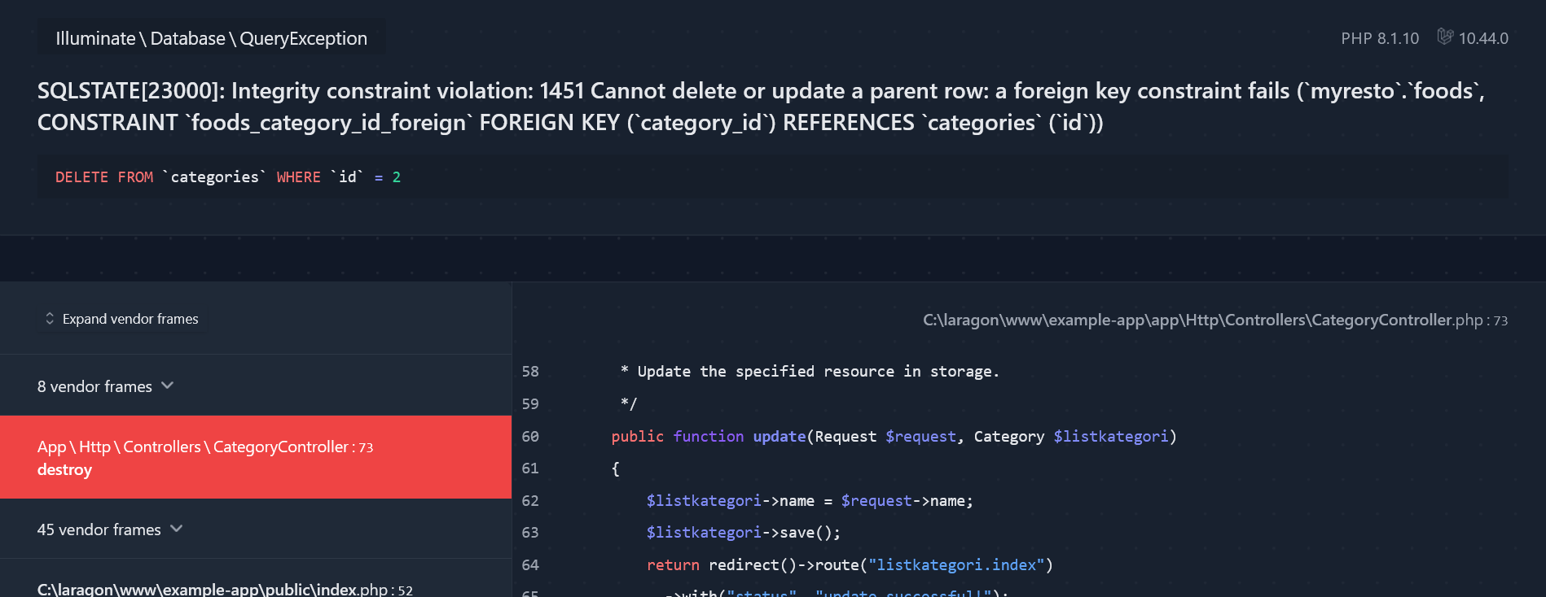
Known Issue
Try to delete type data which is related with some data in hotel table. You will get this error. -> handle it with try and catch
Informatics Engineering | Universitas Surabaya

Slide 28
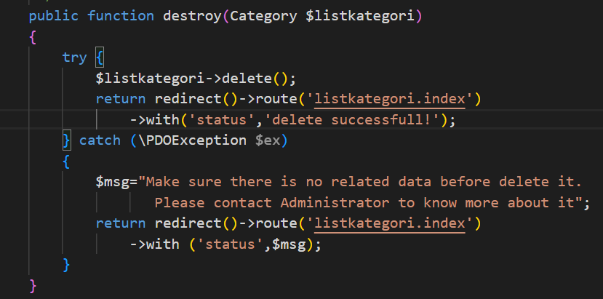
Delete() Function
Modify the destroy() method
Success
handler
Failed
handler
Informatics Engineering | Universitas Surabaya

Slide 29
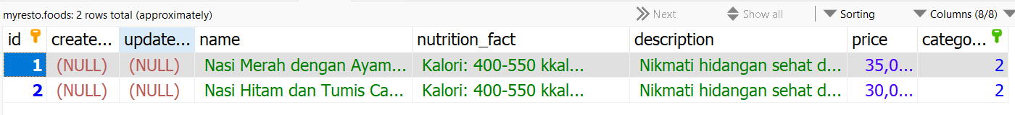
Explanation
The current citizen has a correspondence with 2 contributions. If you want to delete this data, the product owner must move contribution with ID 1 and 2 to another food
Informatics Engineering | Universitas Surabaya

Slide 30
Soft Delete
https://laravel.com/docs/10.x/eloquent#soft-deleting
Informatics Engineering | Universitas Surabaya

Slide 31
Soft Delete
Soft Delete is a mechanism in Laravel that is used to visually “temporarily” delete a record.
Benefits:
Functions as a "recycle bin" of a data
Avoid foreign key constraint errors when deleting a transaction data
Informatics Engineering | Universitas Surabaya

Slide 32
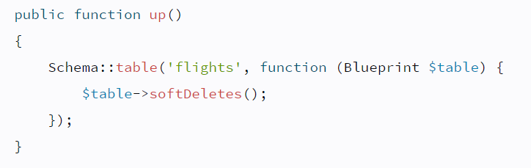
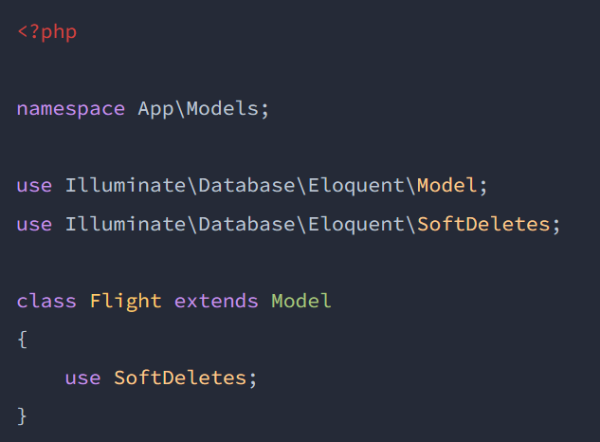
Soft Delete Key
The existence of the "deleted_at" attribute in a table that is given the softdelete feature
There is a keyword use SoftDeletes on php Model
Will form 1 column deleted_at in the database table
Informatics Engineering | Universitas Surabaya

Slide 33
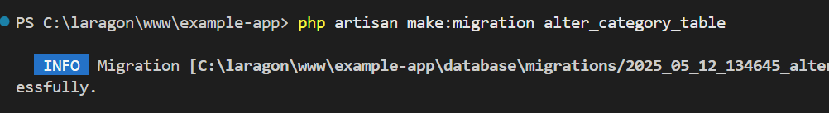
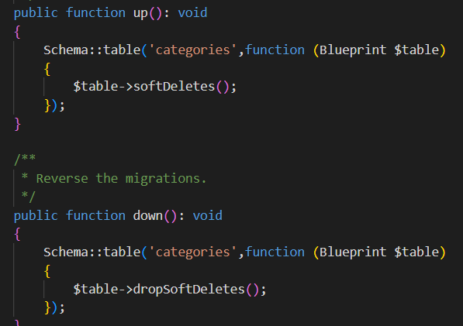
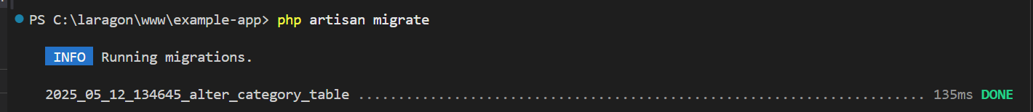
Create a Migration File
Add softDeletes() and dropSoftDeletes() in your new migration file
Informatics Engineering | Universitas Surabaya

Slide 34
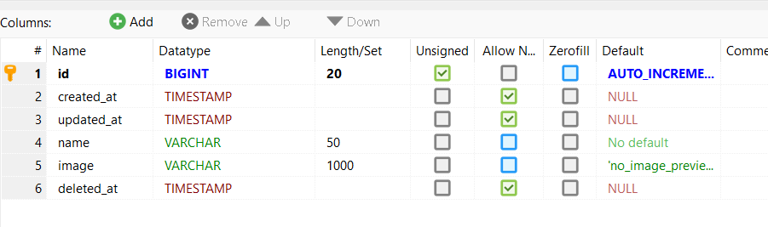
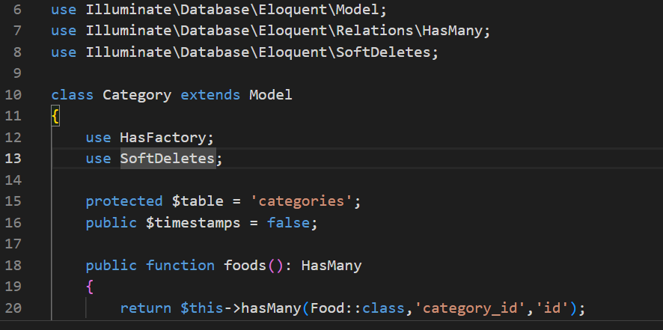
Check Categories Table and Model
Informatics Engineering | Universitas Surabaya

Slide 35
Conclusion
By installing the two syntaxes above, the delete() method on Eloquent will function to fill the 'deleted_at' column with a delete time
Informatics Engineering | Universitas Surabaya

Slide 36
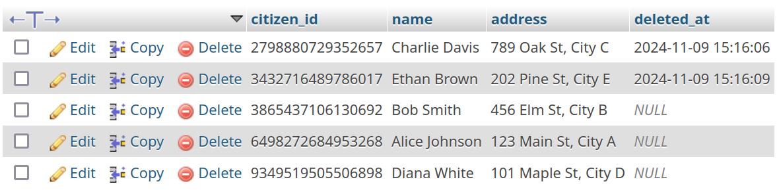
Soft Delete Example
You only use softDelete, and directly your view with Eloquent::all() will automatically update with SoftDeletes Capabilites
Informatics Engineering | Universitas Surabaya

Slide 37
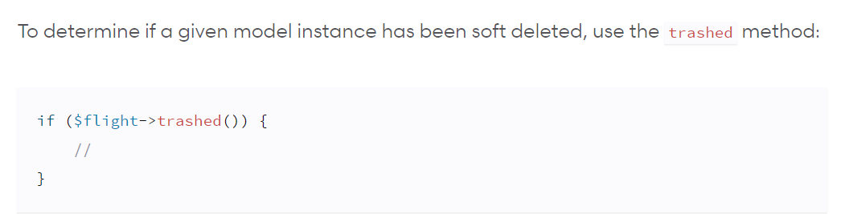
If you want to see the "recycle-bin"
If you want to display deleted data, use the trashed() method on your eloquent object.
Note variable $flight is an eloquent object
Informatics Engineering | Universitas Surabaya

Slide 38
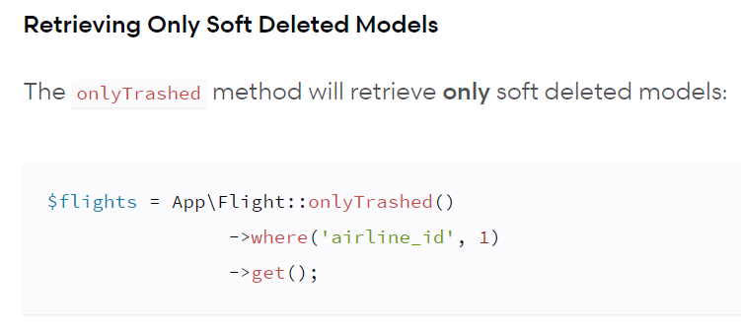
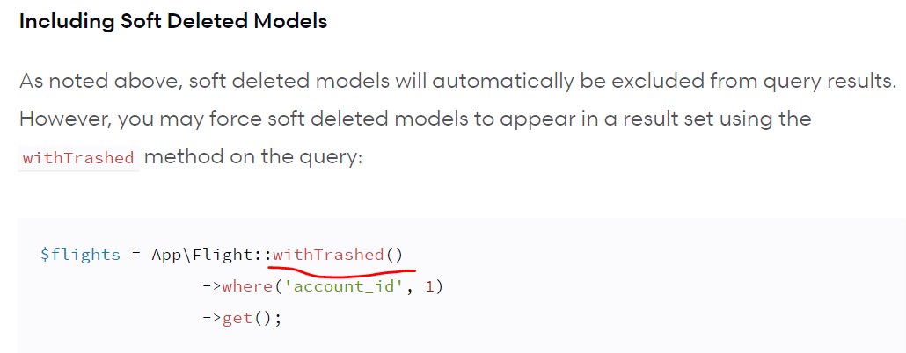
Informatics Engineering | Universitas Surabaya

Slide 39
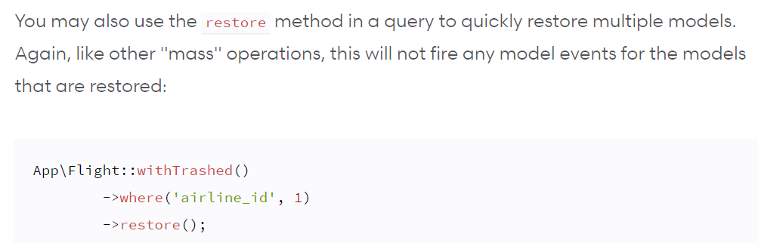
Restore Deleted Data
We use the restore() method
Informatics Engineering | Universitas Surabaya

Slide 40
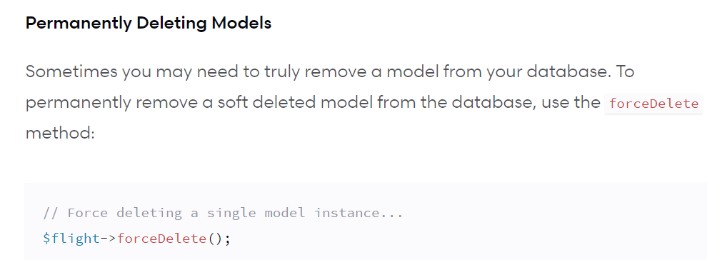
If you want to empty the "recycle-bin"
If you want to completely delete data, use the force Delete() method.
Informatics Engineering | Universitas Surabaya

Slide 41
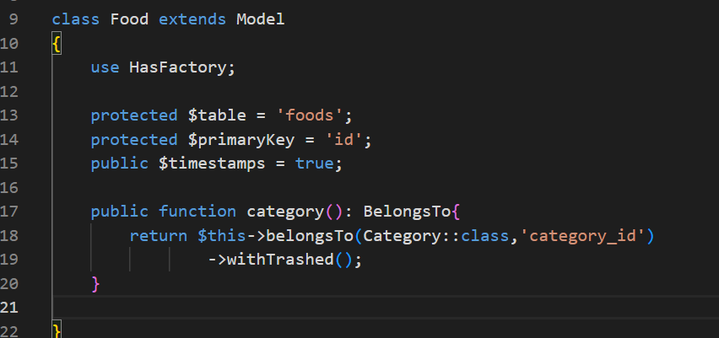
This softDelete will impact into another Data
Try to access ‘food’ page after you finish delete something that has relationship with category. They show error about “non-property” of something.
This happened because your default Relationship will change to adapt the SoftDelete behavior. To fix this, you can use `withTrashed()`
Informatics Engineering | Universitas Surabaya

Slide 42
Homework
Implement Update and Delete function inside
Food page
Category page
Order page
Your progress is to achieve your Final Project Goals
Please do it carefully and consistently!
Informatics Engineering | Universitas Surabaya

Slide 43
Thank You.
Informatics Engineering | Universitas Surabaya

